Slide 1
Combinational Circuits
Unit - 2

Slide 2
Introduction
The outputs of Combinational Logic Circuits are only determined by the logical function of their current input state(s), logic “0” or(and) logic “1”, at any given instant.
Combinational logic circuits give us many useful devices.
One of the simplest is the half adder, which finds the sum of two bits.

Slide 3
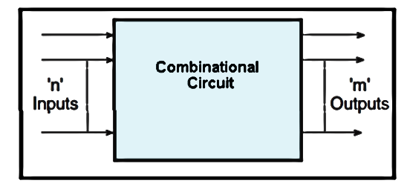
Combinational Logic Circuits

Slide 4
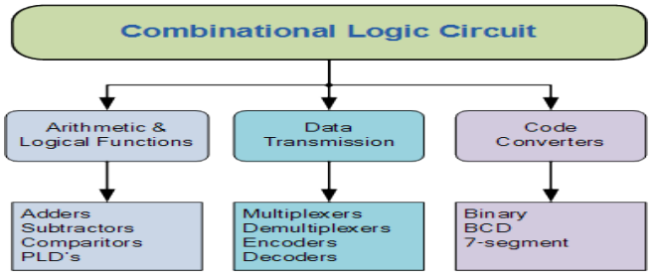
Contd.

Slide 5
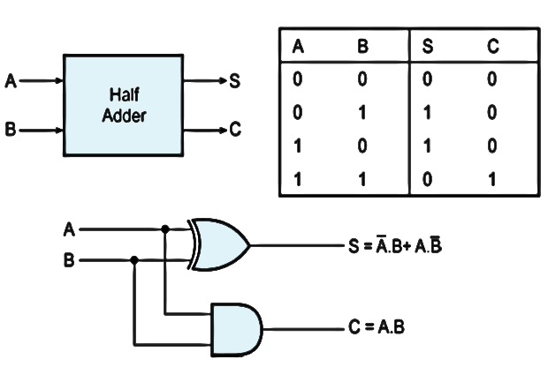
Half Adder

Slide 6
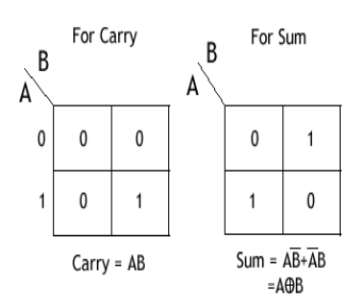
Contd.

Slide 7
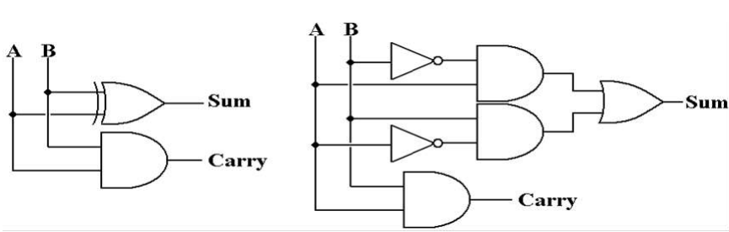
Contd.

Slide 8
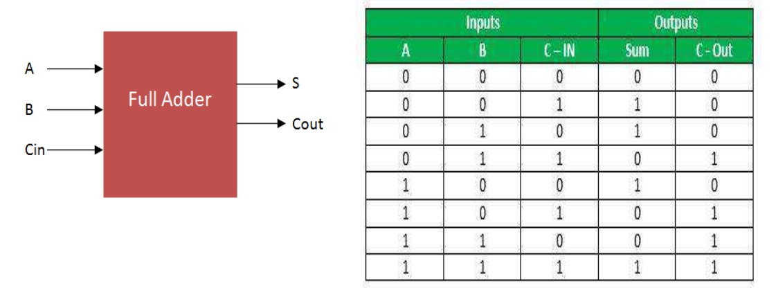
Full Adder

Slide 9
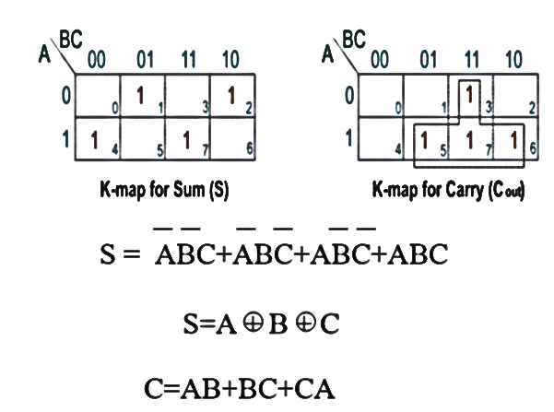
Contd.

Slide 10
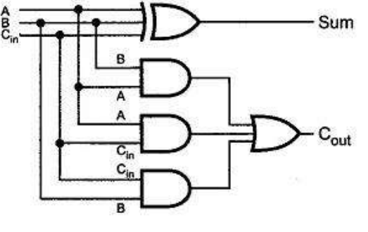
Implemetation of Full Adder

Slide 11
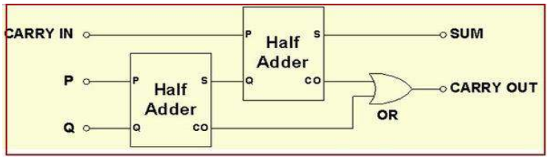
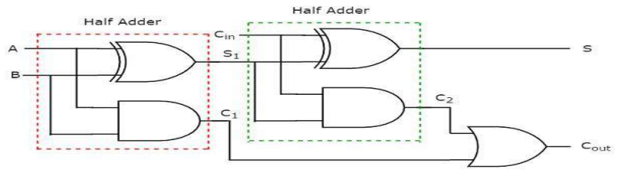
Full Adder using Half Adders

Slide 12
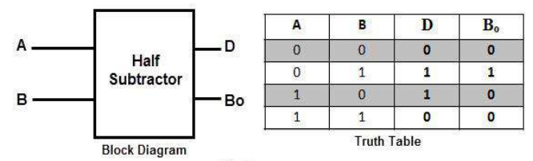
Half Subtractor

Slide 13
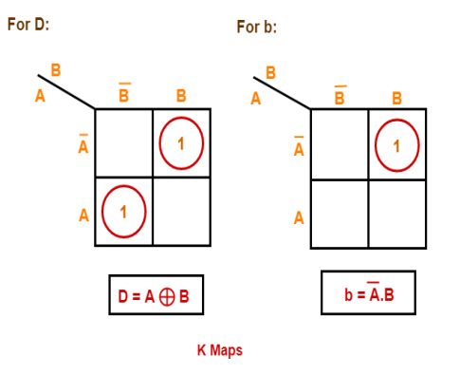
Contd.

Slide 14
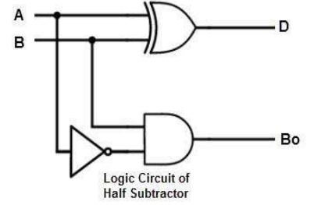
Contd.

Slide 15
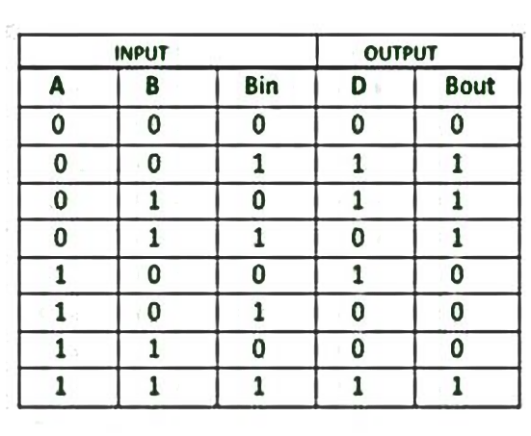
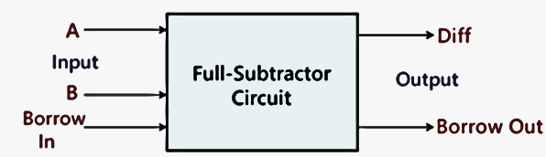
Full Subtractor

Slide 16
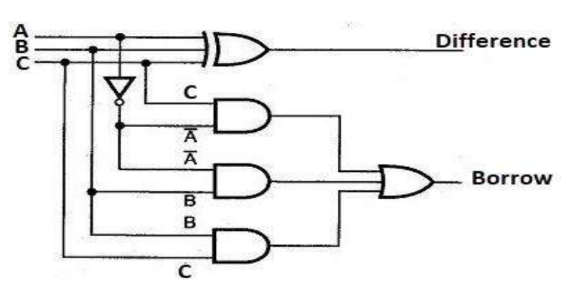
Logic circuit of Full subractor

Slide 17
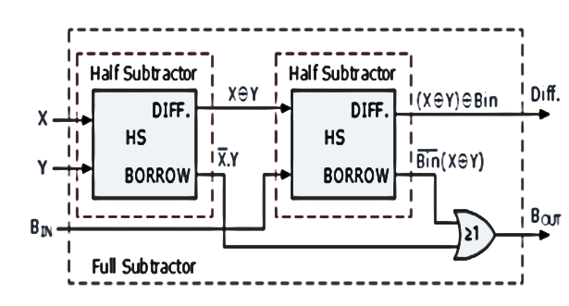
Full Subtractor using Half Subtractor

Slide 18
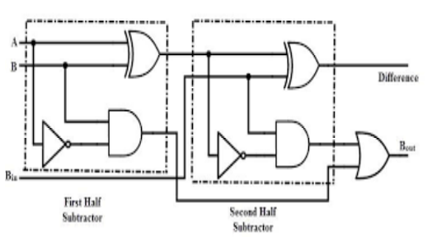
Contd.

Slide 19
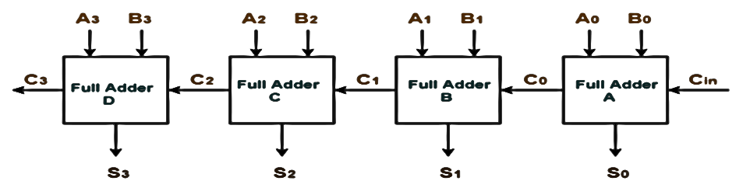
Binary/Ripple Carry Adder
Like we combined half adders to make a full adder, full adders can connected in series.
The carry bit “ripples” from one adder to the next; hence, this configuration is called a ripple-carry adder.

Slide 20
Contd.
In any combinational circuit, the signal must propagate through the gates before the correct output is available in the output terminal.
The total propagation time equal to the propagation delay of a typical gate times multiplied with the gate levels in the circuit.
The propagation delay time in a binary adder is the time it takes the carry to propagate through the full adder.

Slide 21
Contd.
For n-bit adder the total gate delay will be 2n
Eg. For 4-bit binary adder, the propagation delay would be =2n=2*4= 8 gate delays.
So, the carry propagation time is a limiting factor on the speed with which two numbers are added.
To avoid that another adder is widely used which employs the principle of Look-ahead carry.
The adder designed using the principle of Look-ahead carry is called as Look-ahead carry adder or Carry look-ahead adder.

Slide 22
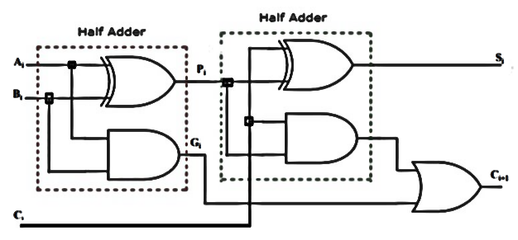
Look-Ahead Carry Adder
The output Sum and Carry can be expressed as:
S_{i} = P_{i} ⊕ C_{i}
C_{i+1} = G_{i} + P_{i} C_{i}

Slide 23
Contd.
P_{i} = A_{i} ⊕ B_{i}
G_{i} = A_{i} B_{i}
G_{i} is called as carry generator and P_{i} is called as carry propagator.

Slide 24
Contd.
C1 = G0 + P0C0
C2 = G1 + P1C1 = G1 + P1 (G0 + P0C0 ) = G1 + P1G0 + P1P0C0
C3 = G2 + P2C2 = G2 + P2G1 + P2P1G0 + P2P1P0C0
C4 = G3 + P3C3 = G3 + P3G2 + P3P2G1 + P3P2P1G0 + P3P2P1P0C0

Slide 25
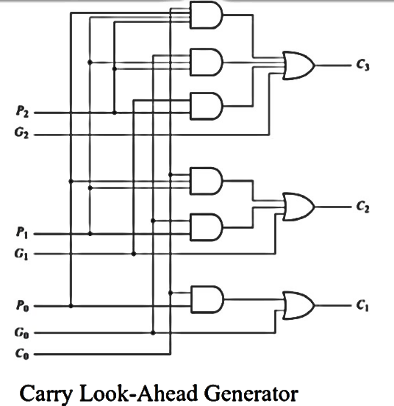

Slide 26
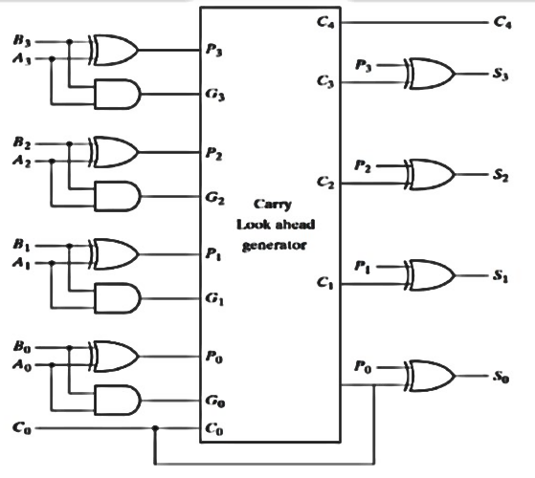

Slide 27
Advantages of CLA:
CLA Adders generate the carry-in for each full adder simultaneously, by using simplified equations involving Pi , Gi , and Cin.
This system reduces the propagation delay.
This is because the output carry at any stage is dependent only on the first Carry signal given at the input.
It is the fastest adder when compared to other addition mechanisms.

Slide 28
Disadvantages:
The carry look-ahead adder circuit gets more complicated as the number of variables increase.
The circuit for a carry look-ahead adder is expensive as it involves more hardware.

Slide 29
Ripple Carry Adder vs. Carry Look Ahead Adder
Ripple Carry Adder | Carry Look Ahead Adder
The Carry bit passes through a long logic chain through the entire circuit. | The Carry bit enters in the system only at the input.
As the full adder blocks are dependent on their predecessor blocks’ carry value, the entire system works a little slow. | Since the entire system depends on the first carry input, the computations are very quick, making it the fastest adder.
It has a simple repetitive design. | Has a slightly complicated design with many logic gates
The ripple carry adder chips have a considerable size and area. | The chip area increases, as there are many components in the circuit.

Slide 30
BCD Adder
A BCD adder, also known as a Binary-Coded Decimal adder, is a digital circuit that performs addition operations on Binary-Coded Decimal numbers
BCD is a numerical representation that uses a four-bit binary code to represent each decimal digit from 0 to 9

Slide 31
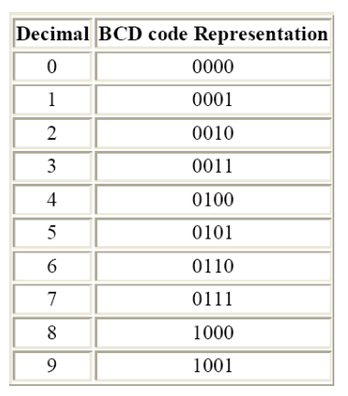
Binary-Coded Decimal

Slide 32
BCD Addition rules
Step 1: Convert the decimal number into BCD representation
Step 2: Perform binary addition on the BCD digits
Case 1: If the sum of the BCD digits is less than or equal to 9 (0000 to 1001 in binary) and no carry, it represents a valid BCD digit.
Case 2: If the sum is less than or equal to 9 (1010 to 1111 in binary), and has carry, simply add the carry to the next higher order bit and add 6 to the result.
Case 3: If the sum is greater than 9 (1010 to 1111 in binary), it has no carry, then add 6 (0110) to the result.

Slide 33
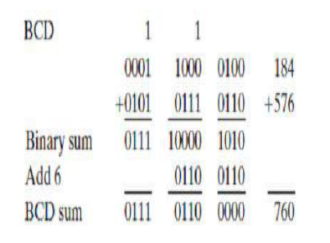
Example:

Slide 34
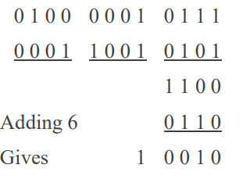
Add BCD of 417 to 195

Slide 35
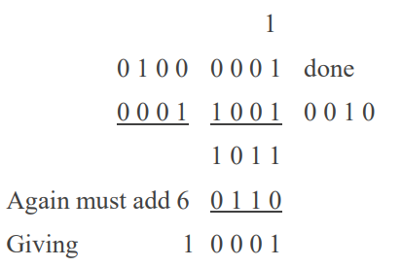
Contd.

Slide 36
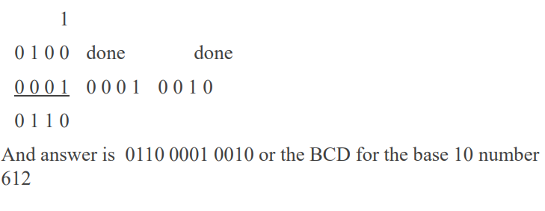
Contd.

Slide 37
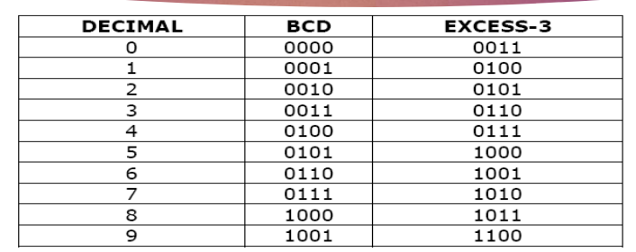
The Excess-3- Code

Slide 38
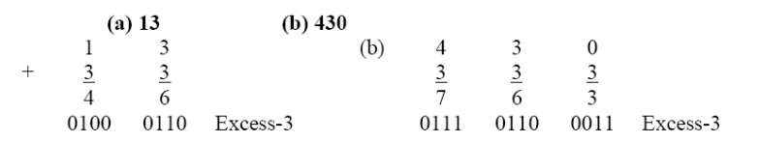
Example:

